Slide 1
Database Management System Unit-I
Mrs. Kanchan M. Bhale
VPKBIET, Baramati
kanchan.bhale@vpkbiet.org

Slide 2
Outline
Components and Structure of DBMS
Multiuser DBMS Architecture
System Catalogs

Slide 4
Storage Manager
A program module that provides the interface between the low-level data stored in the database and the application programs and queries submitted to the system.
The storage manager is responsible to the following tasks:
Interaction with the OS file manager
Efficient storing, retrieving and updating of data
The storage manager components include:
Authorization and integrity manager
Transaction manager
File manager
Buffer manager

Slide 5
Storage Manager
The storage manager implements several data structures as part of the physical system implementation:
Data files -- store the database itself
Data dictionary -- stores metadata about the structure of the database, in particular the schema of the database.
Indices -- can provide fast access to data items. A database index provides pointers to those data items that hold a particular value.

Slide 6
Data Dictionary Storage / System Catalog
A relational database system needs to maintain data about the relations, such as the schema of the relations.
It contains:
Names of the relations.
Names of the attributes of each relation.
Domains and lengths of attributes.
Names of views defined on the database, and definitions of those views.
Integrity constraints (for example, key constraints).

Slide 7
Data Dictionary Storage / System Catalog
In addition, many systems keep the following data on users of the system:
Names of authorized users.
Authorization and accounting information about users.
Passwords or other information used to authenticate users.

Slide 8
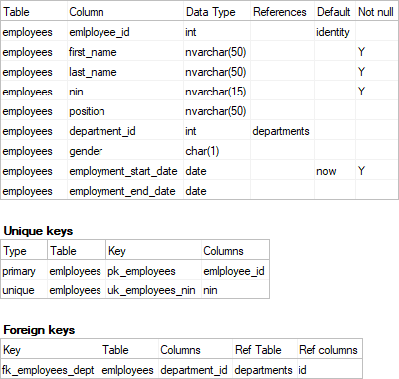
Data Dictionary Example

Slide 9
Query Processor
The query processor components include:
DDL interpreter -- interprets DDL statements and records the definitions in the data dictionary.
DML compiler -- translates DML statements in a query language into an evaluation plan consisting of low-level instructions that the query evaluation engine understands.
The DML compiler performs query optimization; that is, it picks the lowest cost evaluation plan from among the various alternatives.
Query evaluation engine -- executes low-level instructions generated by the DML compiler.

Slide 10
Query Processor

Slide 11
Transaction Management
A transaction is a collection of operations that performs a single logical function in a database application
Transaction-management component ensures that the database remains in a consistent (correct) state despite system failures (e.g., power failures and operating system crashes) and transaction failures.
Concurrency-control manager controls the interaction among the concurrent transactions, to ensure the consistency of the database.

Slide 12
Database Applications
Two-tier architecture -- the application resides at the client machine, where it invokes database system functionality at the server machine
Three-tier architecture -- the client machine acts as a front end and does not contain any direct database calls.
The client end communicates with an application server, usually through a forms interface.
The application server in turn communicates with a database system to access data.

Slide 13
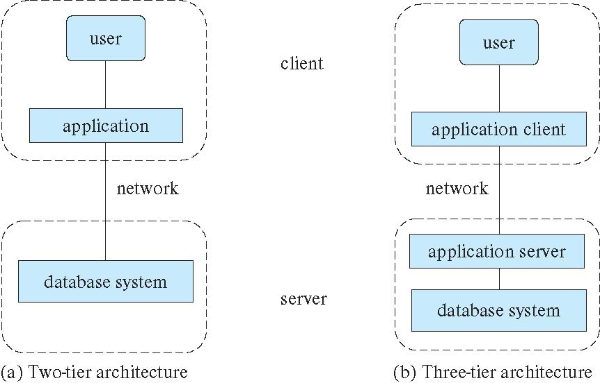
Two Tier & Three Tier Architecture

